Slide 1
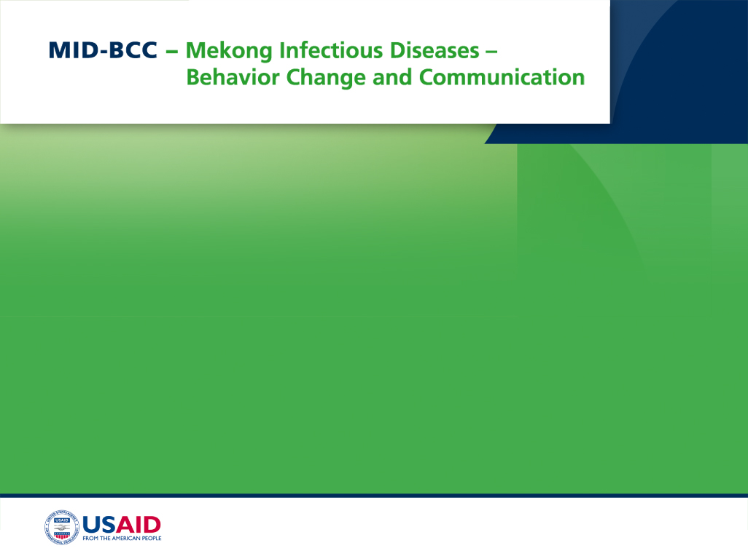
Using Knowledge Attitudes and Practices Survey Results to Design Malaria Prevention Malaria Materials in Thai Border Areas
November 2011

Slide 2

Presenter Disclosures
Tula Michaelides
The following personal financial relationships with commercial interests relevant to this presentation existed during the past 12 months:
No relationships to disclose

Slide 3
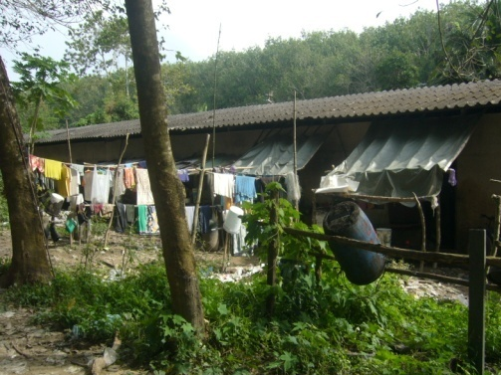
Background & Objectives
To gain an understanding of how to best formulate a communication strategy to reduce the risk of a potential outbreak of ILIs

Slide 4
Background
Phuket was identified as a priority area for malaria elimination.
  It is a major tourist destination
  It attracts migrant workers - majority from Burma working in tourism, construction, fishing and rubber tapping.
Baseline KAP was needed to understand the level of awareness and behavioral compliance among different target audience groups.

Slide 5
Desk Research
Initially - secondary research conducted on migrants, health issues and communication
  Barriers to healthcare due to work location, non-registration/lack of legal access.
  Language barriers, difficulty communicating with healthcare staff.
  Place more trust in health-related information from relatives and friends vs. formal health institutions
We found communication strategies aimed at migrants need to be different compared to the local community.

Slide 6
KAP Objectives
To gain understanding of how to best formulate a communication strategy with the aim of reducing the risk of a potential outbreak of ILIs.
Measure the level of knowledge about common ILIs with focus on symptoms, transmission routes and actions to take to block transmission.
Uncover the extent people engage in preventive behavior and how they are likely to act if an infection occurs.
Identify potential barriers to seeking appropriate care.
Determine media penetration and usage and information sources most relied upon for health related information.
Gain insight into mobile phone usage and potential for using mobile phones as a health communication channel.
Profile different target audience groups based on their level of risk exposure.
Map and profile the different migrant camps included in this study.

Slide 7
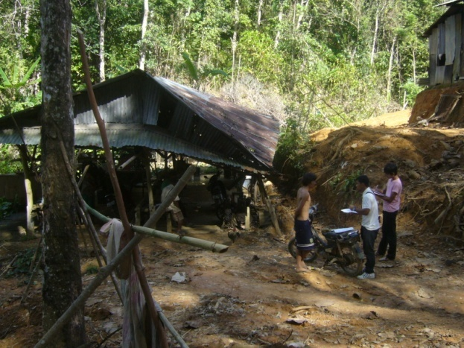
Methodology
Selection of a broad set of migrant camps across industries and malaria transmission risk zones, together with neighboring Thai communities

Slide 8
Target Groups
Local Thai communities
Households from the lower socioeconomic classes including those with a monthly household income of around 15,000 Baht (USD 500) or less.
Burmese Migrants (including both registered and non-registered migrants)
Selected at random within pre-determined camps based on a listing from Malaria Unit in Phuket. Soft quotas were used to ensure a mixture of Burmese and Mon migrants in camps located in construction sites, fishing villages and rubber tapper camps.

Slide 9
Sample Design
Selected migrants living in 15 camps based on previous qualitative research by the Kenan Institute and the Malaria Unit in Phuket that had already mapped most migrant camps.
Selected across industry of engagement (migrants working in construction, fishing and rubber tapping have different risk exposures/locations) and malaria transmission risk zone (based on Malaria Unit classification into high and moderate risk groups). Additional camps, classified as being in a low risk zone, were also identified.
Thai communities selected in the vicinity of each camp to ensure that geographical spread and risk zones of the two samples were similar.
The Thai sample serves as a type of control group vs. the more vulnerable migrant communities.

Slide 10
Sampling and Sample Size
Sampling was carried out through random selection of households within the pre-selected migrant camps and Thai communities followed by the Kish Grid method for random selection of an adult within the household.
Fieldwork was carried out from 11 October until 16 November, 2010
All interviews were carried out face to face.
The final sample distribution is shown in the table below. No weighting has been applied as there is no record of the size or distribution of the migrant population.
Malaria Transmission Risk | Migrant Rubber Tapping (n) | Migrant Fishing (n) | Migrant Construction (n) | Thai Community (n) | Total (n)
High | 39 | 10 | 100 | 200 | 349
Moderate | 50 | 45 | 50 | 100 | 245
Low | 11 | 45 | 50 | 100 | 206
Total | 100 | 100 | 200 | 400 | 800

Slide 11
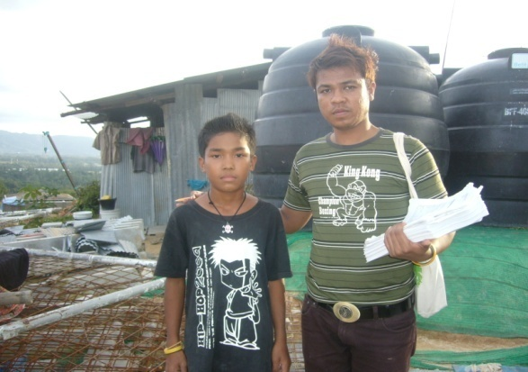
Key Segment Profiles
Migrants and Thai segments as well as migrant sub-segments

Slide 12
Respondent Segments
Thai Origin
Migrant Origin
Migrant Status
Most of the Thais interviewed were local Thais who grew up in Phuket but some moved in from other provinces. Migrants were split nearly 50/50 between Burmese and Mon and three our of four migrants interviewed were registered.
Base: All respondents (Thai n=400, Migrants n=400)

Slide 13
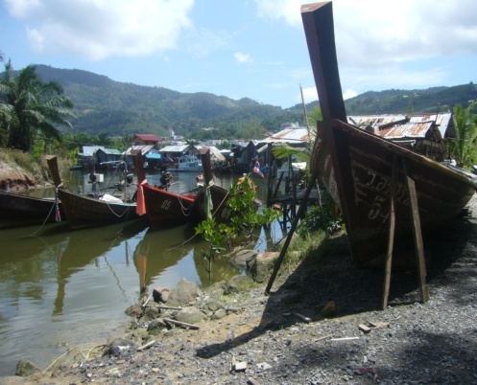
Knowledge about Influenza Like Illnesses
Symptoms, transmission routes and how to block transmission in relation to malaria, dengue and avian influenza.

Slide 14
Knowledge of Malaria
Thai
Migrants
80% for Low malaria transmission risk zone
Majority of migrants are aware of malaria; among the Thai population it is 100 %.
Awareness across different migrant groups did not differ significantly and shows that malaria is a disease that people in general know something about.
The only group found with a somewhat lower score were migrants located in low risk malaria zones. This could be explained by the Malaria Unit having done previous activities in camps with higher risk.
Base: All respondents (Thai n=400, Migrants n=400)

Slide 15
Malaria Symptoms
Identified from show card pictures
Correct recognition of high fever and cold shivers is relatively high, especially among the Thai population.
For other malaria symptoms there is a recognition gap, especially among the migrants.
Symptoms which are more relevant for other ILIs are associated with malaria by many people and again, a larger proportion of the migrants have incorrect knowledge here.
Base: Those aware of malaria (Thai n=398, Migrants n=352)

Slide 16
Malaria Transmission Routes
Identified from show card pictures
The transmission route for malaria is via night time mosquitoes. Migrants have better knowledge about this compared to the Thais. Both groups have large proportions of people who are confused on this issue, thinking that day time mosquitoes are a possible vector. Some migrants also recognize other, incorrect transmission routes such as water and infected people.
Base: Those aware of malaria (Thai n=398, Migrants n=352)

Slide 17
Association with Day Time Mosquitoes
Proportion who get it wrong
Thai
Migrants
Migrant Risk Group | %
Rubber Tappers | 55
Moderate malaria transmission Risk Zones | 53
Aged 35-49 | 54
For the Thai population the incorrect association between malaria and daytime mosquitoes was strongly associated with current main activity. Those studying have better knowledge than those unemployed or engaged with home duties.
Within the migrant population the results were more even, but rubber tappers -- who live in the forests and are at most risk -- are less educated on the issue.
Base: Those aware of malaria (Thai n=398, Migrants n=352)

Slide 18
Blocking Malaria Transmission
Identified from show card pictures
While the association between malaria and night time mosquitoes was not clear, people were aware that mosquito nets can block transmission. In this area migrants appeared to have better knowledge than the Thais. For the migrants, however, several incorrect associations remained.
Base: Those aware of malaria (Thai n=398, Migrants n=352)

Slide 19
Knowledge of Dengue
Thai
Migrants
73% for Mon
83% who are not aware of Malaria are also not aware of Dengue
Thais are 100% aware of dengue but one in five migrants are not aware. There were no real significant differences between migrant sub groups but fewer Mon were found to be aware about dengue with 73%. If a migrant is not aware of malaria then it is very likely they are not aware of dengue.
Base: All respondents (Thai n=400, Migrants n=400)

Slide 20
Dengue Symptoms
Identified from show card pictures
Apart from fever and cols shivers, Thais are aware of red spots or rashes. Migrants, on the other hand have higher awareness about joint pain, red eyes and prolonged tiredness. Overall it would appear that a Thais have a better chance of recognizing the symptoms of dengue compared to migrants.
Base: Those aware of dengue (Thai n=400, Migrants n=319)

Slide 21
Dengue Transmission Routes
Identified from show card pictures
The transmission routes for dengue, through day time mosquitoes, is less confused compared to malaria. The majority of both Thais and migrants got it right but there are still large proportions of both groups who associate transmission with night time mosquitoes.
Base: Those aware of dengue (Thai n=400, Migrants n=319)

Slide 22
Blocking Dengue Transmission
Identified from show card pictures
Mosquito nets , window screens and repellant top the list.
An increasing number mention other ways to block transmission, such as residual spraying, not leaving empty containers, and covering water storage containers. The incorrect association with infected people and food remains with migrants.
Base: Those aware of dengue (Thai n=400, Migrants n=319)

Slide 23
Knowledge of H1N5 / H1N1
Thai
Migrants
58% for Low malaria transmission risk zone
13 out of the 15 camps have chickens and/or ducks running around freely
Knowledge of H1N5 virus or H1N1 virus is also high among the Thais, with near 100 % being aware of this type of disease.
For migrants, awareness is much lower, with only two in three migrants being aware.
Again, awareness was found to be lower still among migrants in camps in low risk malaria transmission zones.
Base: All respondents (Thai n=400, Migrants n=400)

Slide 24
H1N5 / H1N1 Symptoms
Identified from show card pictures
High fever is the only symptom with relatively high awareness, although it is significantly lower for migrants. For other relevant symptoms there is a significant gap in knowledge; this is not surprising given influenza diseases are relatively new compared to malaria and dengue.
Base: Those aware of H1N5 / H1N1 (Thai n=397, Migrants n=265)

Slide 25
H1N5 / H1N1 Transmission Routes
Identified from show card pictures
What people do know is that transmission comes from chickens and ducks and to some extent infected people. Migrants are at a disadvantage here, with significantly less knowledge compared to Thai.
Base: Those aware of H1N5 / H1N1 (Thai n=397, Migrants n=265)

Slide 26
Blocking H1N5 / H1N1 Transmission
Identified from show card pictures
Unlike dengue and malaria, these types of influenzas are clearly distinct when it comes to associated transmission routes. While the knowledge among migrants is lower compared to Thais, a similar and rather strong distinction between the different diseases can be seen.
Base: Those aware of H1N5 / H1N1 (Thai n=397, Migrants n=265)

Slide 27
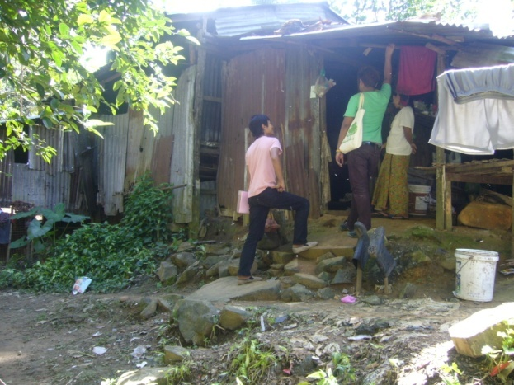
Preventive Behavior
To what extent are Thai and migrants protecting themselves from contracting ILIs

Slide 28
Use of Window Screens
Observation
Thai
Migrants
Nearly half the Thai population do not use window screens but those who do will in most cases have them on all windows. The migrants are at a disadvantage here due to camp conditions and just about all of them have no type of screen protection against mosquitoes unless they use a net.
Base: All respondents (Thai n=400, Migrants n=400)

Slide 29
Littering of Water Collecting Containers
Observation
Thai Households
Migrant Households
Migrant Camps
Around Thai households it is relatively clean and there are very few instances when you see large amounts of water-collecting containers lying around. The same applies to migrant households. However, from observation around the migrant communities, there were often instances where you could find large amounts of rubbish lying around elsewhere in the community such as a public garbage dump.
Base: All respondents (Thai n=400, Migrants n=400)

Slide 30
Mosquito Net, Repellent and Coil
Observation
Observed in home
Condition of mosquito net
Fewer (77%) unregistered migrants have nets
Most migrants have mosquito nets and nine out of 10 are in good condition with no holes in them. Many also use mosquito coils, but repellant is used to a lesser extent. Fewer Thais use mosquito nets as many have window screens. Using nets did not vary between those aware of malaria or not aware, suggesting some use nets just to avoid mosquito bites.
Base: All respondents (Thai n=400, Migrants n=400)
Base: Those with mosquito nets (Thai n=98, Migrants n=338)

Slide 31
Preventive Practice for ILIs
Thai
Extent of practice
Reason for NOT always using mosquito nets
Thai communities don’t actively protect themselves against mosquitoes and in most cases this is due to having their windows fitted with screens. Hence, the main reason for not using them is that they don’t feel it is needed.
No one seems to practice good hygiene etiquette - coughs or sneezes into the elbow.
Base: All Thai respondents (n=400)
Base: Those not always using mosquito nets (n=319)

Slide 32
Preventive Practice for ILIs
Migrants
Extent of practice
Reason for NOT always using mosquito nets
Fewer (74%) unregistered migrants always use a net
One in five migrants don’t always use a mosquito net and the main reason is that it is too hot. Unlike the Thai communities, some camps don’t have electricity and so there is no opportunity to use a fan. However, using repellant when working outside is just the opposite with only one in five migrants practicing.
Base: All Migrant respondents (n=400)
Base: Those not always using mosquito nets (n=80)

Slide 33
At Risk of Exposure to Malaria Vectors
Thai
Migrants
Taking into account the combination of either having screen on all windows or using mosquito nets, it was found that many Thais who don’t have window screens do use mosquito nets to a greater extent. However, many use neither and results in many Thais being at risk of exposing themselves to malaria vectors. Because Thai communities are in the vicinity of the migrant camps, the risk of exposure may be greater but vectors of course are more likely to originate in the migrant camps.
Base: All respondents (Thai n=400, Migrants n=400)

Slide 34
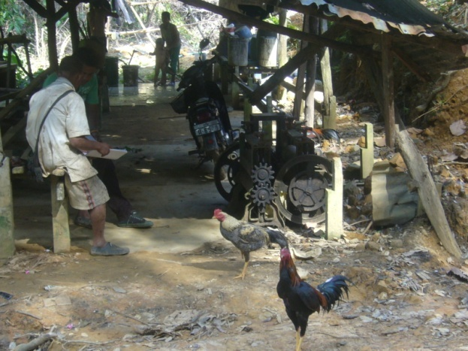
Health Seeking Behavior
What Thai and Migrants do when they become ill with influenza like symptoms, such as high fever and shivers

Slide 35
Who Would You Ask for Advice?
Symptom: High fever and cold shivers
High fever and cold shivers were used as a hypothetical scenario to obtain information on health seeking behavior. The majority of both Thais and migrants would seek advice from a doctor should they come down with high fever and cold shivers. Migrants are also likely to seek advice from family and friends and may seek advice from their employer as well.
Base: All respondents (Thai n=400, Migrants n=400)

Slide 36
Where Would You Go For Treatment?
Symptom: High fever and cold shivers
Reason for NOT going to hospital or clinic
 | Thai n=9* (%) | Migrants n=14* (%)
Language | 0 | 71
No Health Card | 0 | 29
Too expensive | 22 | 43
Don’t trust | 22 | 14
Too far away | 11 | 29
Can’t do better | 11 | 7
Waiting too long | 44 | 14
Other | 11 | 21
*Small base
The vast majority would seek treatment at a hospital or clinic. In Phuket there are plenty of small clinics around and unregistered migrants may seek treatment there if they can afford it. Government hospitals are cheaper and often preferred by migrants but the employer may have to bribe police to enable transportation should the worker not be registered. Since two thirds of migrants can speak some Thai as well as English, language was not found to be a major barrier.
Base: All respondents (Thai n=400, Migrants n=400)
Base: Those not going to a hospital or clinic

Slide 37
Ever bought Medicine?
Symptom: High fever and cold shivers
Type of medicine and location
Thai
 | Thai n=277 (%)
Type of medicine
Fever reducing | 99
Antibiotics | 11
Herbal | 1
Other | 0
Location
Pharmacy | 51
Local drug store | 48
Hospital / Clinic | 1
Other | 0
In response to high fever and cold shivers, two thirds of Thais have bought fever reducing medicine in the past. Some also buy antibiotics. They will purchase the medicine either at the pharmacy or local drug store.
Base: All Thai respondents (n=400)
Base: Those who bought medicine

Slide 38
Ever bought Medicine?
Symptom: High fever and cold shivers
Type of medicine and location
Migrants
 | Migrants n=222 (%)
Type of medicine
Fever reducing | 97
Antibiotics | 11
Herbal | 6
Other | 1
Location
Pharmacy | 4
Local drug store | 92
Govn’t health center | 4
Other | 0
Just over half of the migrants have purchased medicine for high fever and cold shivers and fever reducing medicine is most common. Migrants prefer to go to the local drug store as it is cheaper and usually closer at hand.
Base: All Migrant respondents (n=400)
Base: Those who bought medicine

Slide 39
Health Seeking Behavior After Treatment
At hospital or clinic
If the hospital or clinic prescribes medicine, both Thais and migrants will take it as prescribed but some Thais may stop taking the medicine should the symptoms disappear. Both groups will go back for check up but some Thais may only do it if they are told. This indicates that treatment is likely to be followed through for most patients who are admitted for ILIs.
Base: Those who would seek treatment at a hospital or clinic
(Thai n=391 , Migrants n=386)

Slide 40
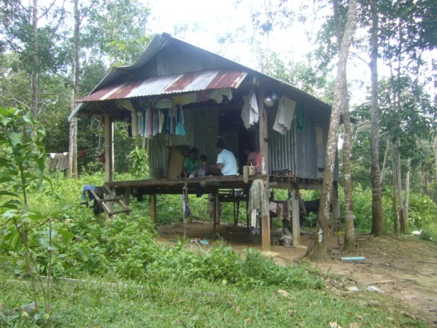
Health Seeking Behaviour - Children 0-5 years
What Thais and Migrants believe they will do if their child becomes ill

Slide 41
Would Go to Hospital or Clinic
Symptom in Child: High fever and cold shivers
Thai
Migrants
Health seeking behavior is stronger for children and nearly all Thais and migrants would seek care in a hospital or clinic should their child become ill.
Base: Those with children under 5 years
(Thai n=106 , Migrants n=77)

Slide 42
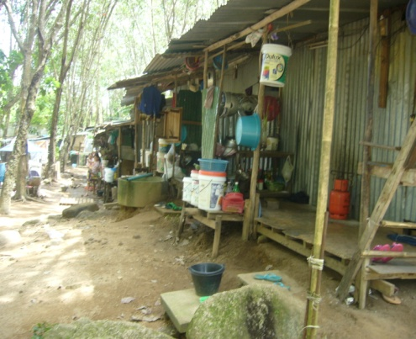
Media Penetration and Usage
Mainstream media and mobile phones

Slide 43
Media Penetration & Consumption
Media in household
Media consumed in past 7 days
Registered 65%
Unregistered 50%
Registered 31%
Unregistered 49%
Registered 34%
Unregistered 50%
There is a distinct difference between migrants and Thais when it comes to media penetration and consumption. One in three migrants, or one in two for unregistered migrants, don’t have access to any media. The only way to communicate to these migrants would be through HCW, word of mouth or through their employer.
Base: All respondents (Thai n=400, Migrants n=400)

Slide 44
Media Consumption
Television
Radio
Television, as expected, is watched at night between 6 and 9 pm. Radio on the other hand can be listened to throughout the day and some listen to the radio through their mobile phone. The general media consumption pattern for Thais and migrants is quite similar.
Base: Those consuming the media in the past 7 days (Thai n=397 / 233 , Migrants n=243 / 26)

Slide 45
Media Consumption
Thais only (migrant base too small)
Newspaper
Internet
Newspapers are mainly read in the morning or before lunch while most people access the internet at night after 6pm. Migrants are not shown here due to limited sample size.
Base: Thais consuming the media in the past 7 days (n=228 / 108)

Slide 46
Mobile Phone Penetration
Thai
Migrants
53% for unregistered
Service Provider | n=372 (%)
AIS | 41
DTAC | 52
True Move | 7
Service Provider | n=244 (%)
AIS | 3
DTAC | 97
True Move | 0
Mobile phone penetration is very high among the Thai population at 93 percent. It is surprisingly high among migrants as well: nearly two in three migrants have a connected mobile phone. Migrants almost exclusively use DTAC. This is a result of DTAC promotion activities, offering reduced call rates between phones within the DTAC network.
Base: All respondents (Thai n=400, Migrants n=400)
Base: Those with mobile phones

Slide 47
Media Relied on For Health Information
Thai
Migrants
It is interesting to see the impact achieved by local HCWs. They are relied upon by 69 percent of Thais and 49 percent of migrants. Whilst Thais rely heavily on mainstream media (which will broadcast PSAs), migrants are far more reliant on outreach activities as well as talking to friends. This is consistent with the low media penetration among migrants. Employers represent a smaller but potentially significant source for migrants and perhaps employers could play a greater role.
Base: All respondents (Thai n=400, Migrants n=400)

Slide 48
Media Exposure by Disease
Thai
Migrants
Media | Malaria n=398 (%) | Dengue n=400 (%) | H1N5/N1 n=397 (%)
TV | 93 | 94 | 98
HCWs | 66 | 66 | 64
Newspaper | 24 | 23 | 31
W-O-M | 23 | 22 | 29
Radio | 12 | 11 | 20
Posters | 2 | 2 | 10
Employer | 0 | 0 | 1
Average no. of media sources | 2.2 | 2.2 | 2.5
Media | Malaria n=352 (%) | Dengue n=319 (%) | H1N5/N1 n=265 (%)
TV | 42 | 39 | 40
HCWs | 49 | 50 | 55
Newspaper | 2 | 3 | 2
W-O-M | 58 | 57 | 56
Radio | 5 | 4 | 4
Posters | 6 | 6 | 6
Employer | 10 | 10 | 15
Average no. of media sources | 1.7 | 1.7 | 1.8
Media exposure for different ILIs follows the source media for health related information very closely. The difference between different ILIs is not hugely different although it appears there may have been a recent push for H1N5/H1N1. Again, the distinction between migrants and Thais can be seen in that migrants rely more heavily on informal media and overall, they have access to fewer media sources.
Base: Those aware of the disease

Slide 49
Communication Strategies:
Channels for Migrants
Migrants cannot effectively be reached through mainstream media and need to be reached on the ground in the camps.
Potential for a ‘viral campaign’ through human interaction through:
  Employers: Have an interest in keeping workers healthy but need education.
  Migrant (Burmese and Mon) opinion leaders: Most likely registered and have been in Thailand for some time and know many people. Can probably also speak Thai.
  Health Care Workers: Already on the ground but may need communication materials and capacity development for more effective communication.
Many migrants have a working mobile phone and nearly all use DTAC. There is strong potential to develop a Mobile Phone Panel with selected migrants in each camp to both disseminate information as well as regularly collect data to monitor camp conditions in relation to ILIs.

Slide 50
Communication Strategies:
Messages for Migrants
Dengue
Reduce favorable conditions for vectors (e.g., get rid of containers that can collect water).
Combine with a campaign for a monthly camp clean up day or drive to recycle empty plastic containers.
Malaria/Dengue
Distribute nets to unregistered migrants, along with messages on risks of malaria and night time mosquitoes.
Seek care immediately for ILI symptoms, especially when returning from Burma.
Remind to use lotions, sprays and coils when working on the plantation.
Influenza
General education is needed, especially pandemic influenza, because one third is completely unaware.

Slide 51
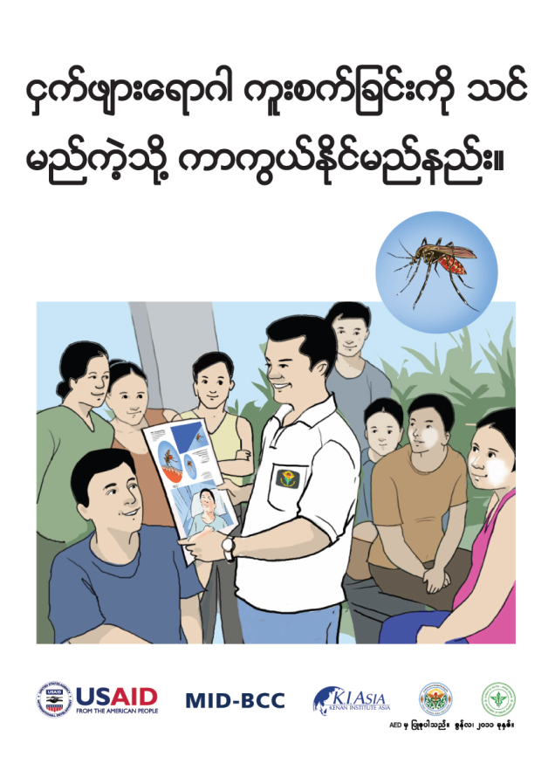
Communication Strategies:
Materials for Migrants

Slide 52
Communication Strategies:
Messages for Thai Community
Malaria
Use window screens, nets and repellant.
Seek treatment promptly
Dengue
Empty and clean containers filled with water.

Slide 53
Lessons Learned
Insightful information was gleaned from organizations with direct experience on the ground in Phuket, and supervisors’ general observations in/around camps provided valuable context/insight.
Registration for Burmese and Mon nationals is an issue – for medical care, work permits, etc.
Was effective to ask about possession of health care cards (not legal status) at end of interview.
Difficult to develop representative sampling plan because no official record of migrants, but sampling across different types of camps based on industry and malaria transmission risk was sound and could be replicated.
Use of show card pictures (as opposed to reading questions aloud) worked well, especially with the migrant respondents.
There is no electronic font for Mon, so Burmese questionnaires were used by interviewers who spoke both Burmese and Mon.

Slide 54
Communication Follow-Up
Job aids and associated activities have strengthened the role of the Phuket Malaria Unit.
  Migrants have come to trust the Malaria Unit.
  Malaria Unit logo placed on shirts/jackets and depicted in the materials; materials specifically say that HCWs, migrant volunteers and malaria unit are people they can contact (and trust) to get more information.
  Raises esteem of workers and strengthens credibility.
Designed low-lit materials because about half of migrants/volunteers are illiterate in Thai and Burmese.
  Extensive pretesting to ensure illustrations were informative, even without the text.
  Prior to these materials, most materials relied on a lot of text and too much technical information.

Slide 55
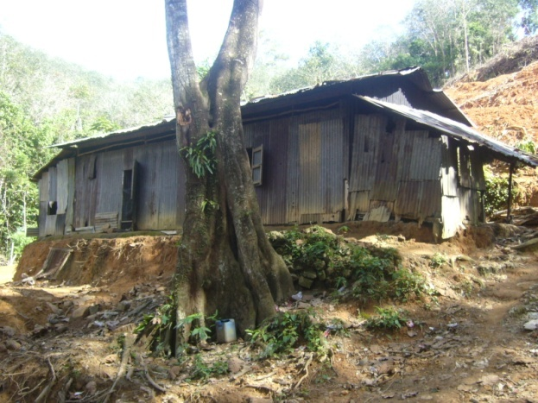
Contact Information
For information about this study, please contact Robert Kelly at:
T: +66 2 632 1117
E:rkelly@fhi360.org

